Slide 1

Evaluate Solutions and Select Vendors for Zero Trust (ZT)
current models and applications
Easton Soares
Ismail Mahamed
Jaskaran Sohal
Rayyan Khan
Group 9

Slide 2
Table of contents
3-5 | Identity Pillar
6-8 | Devices Pillar
9-11 | Network Pillar
12-14 | Applications and Workloads Pillar
15-17 | Data Pillar
18 | References
19 | About Us

Slide 3
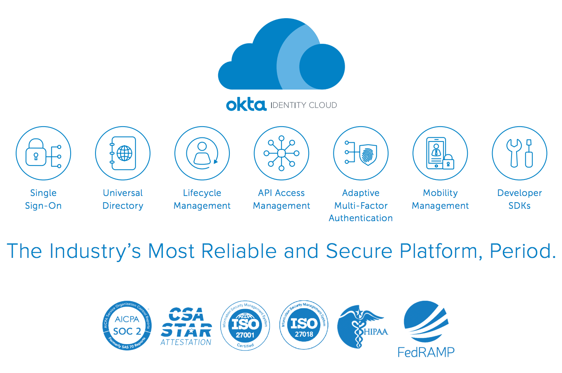
IDENTITY PILLAR
Solution
Okta Identity Cloud, integrated with Salesforce CRM.

Slide 4
IDENTITY PILLAR
RATIONALE
In a diverse work environment with a mix of onsite and remote employees, including those from APAC, EMEA, and Europe, managing identities securely and efficiently becomes paramount. Okta offers a comprehensive identity management solution that can handle complex scenarios, including multi-factor authentication (MFA), single sign-on (SSO), and identity lifecycle management. The integration with Salesforce CRM ensures that identity management is seamless and secure, adapting to the varying needs of a global workforce.
The use of Okta supports Zero Trust principles by verifying every user's identity with robust, adaptable authentication mechanisms. It also provides the flexibility to scale as the company grows and the nature of the workforce changes. The ability to integrate with other security tools and platforms enhances its utility, making it an ideal choice for managing identities across diverse environments.

Slide 5
IDENTITY PILLAR
Implementation
Implementing Okta for Salesforce CRM involves several steps. Firstly, enable SSO to ensure that users have a single set of credentials across all applications, reducing the risk of password fatigue and related security issues. Implement adaptive MFA, where the authentication requirements change based on contextual factors such as the user's location, device, and network security.
For remote employees, especially those in different regions, implement geolocation-based access controls. Users attempting to access the CRM from new locations or unknown devices can be prompted for additional authentication steps.
Automate user provisioning and deprovisioning to ensure that access rights are updated in real-time based on the employee's role and status within the company. This reduces the risk of former employees retaining access and eases the onboarding process for new hires.
Integrate Okta's advanced reporting and analytics features to monitor and analyze access patterns, helping to detect and respond to unusual activities that could indicate a security threat.

Slide 6
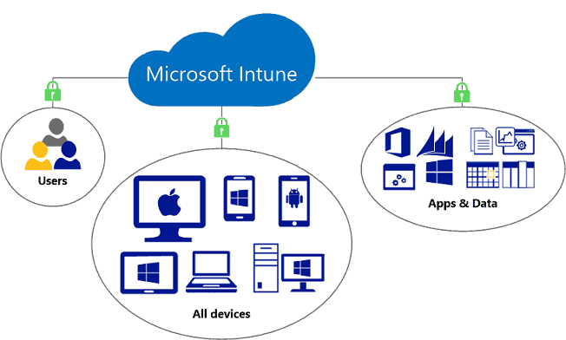
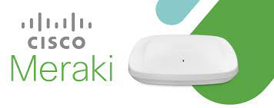
Devices PILLAR
Solution
Microsoft Intune, augmented with Cisco Meraki for network security.

Slide 7
Devices PILLAR
rationale
In a hybrid work environment, ensuring the security of devices that access the CRM is critical. Microsoft Intune offers comprehensive device management and security capabilities suitable for a variety of devices, including smartphones, tablets, and laptops. Its ability to manage both company-issued and personal devices (BYOD) is particularly important for a workforce that is partly remote and globally distributed.
Cisco Meraki complements Intune by providing network security features that protect the devices when they are accessing the CRM, especially important for remote workers who might be using unsecured or public networks. Together, they create a robust security environment for devices accessing sensitive CRM data.

Slide 8
Devices PILLAR
implementation
Deploy Microsoft Intune for device management, enforcing security policies such as encryption, anti-malware protection, and ensuring that devices are up-to-date with the latest security patches. For BYOD scenarios, implement a containerization strategy where company data is segregated from personal data, ensuring security without infringing on personal privacy.
Implement Cisco Meraki to provide secure network access. Use its features to create a secure VPN for remote workers, ensuring that their connection to the CRM is encrypted and protected from potential network threats.
Implement device compliance policies within Intune, ensuring that only devices that meet your security standards can access the CRM. In case of non-compliance, these devices should be restricted from accessing sensitive data.
Use Meraki’s dashboard to monitor network traffic and identify potential security threats in real-time. Implement automated alerts to notify IT staff of unusual activities that could indicate a compromised device.

Slide 9
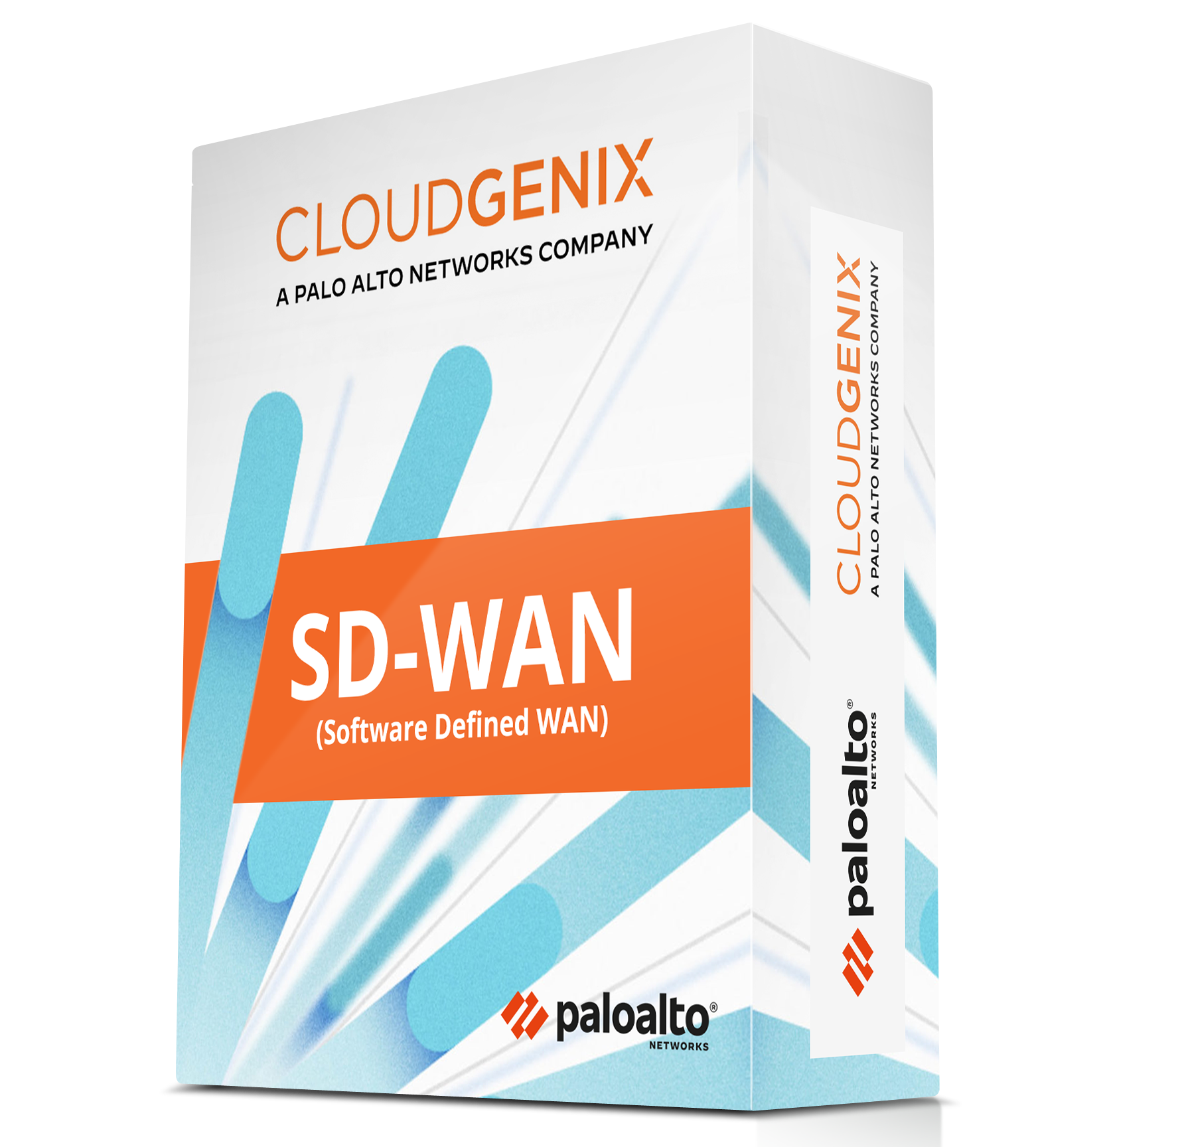
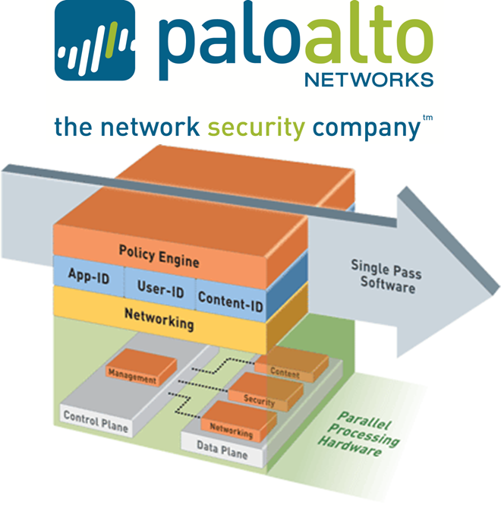
Networks PILLAR
Solution
Palo Alto Networks’ Next-Generation Firewall and CloudGenix SD-WAN.

Slide 10
networks PILLAR
rationale
Network security is a cornerstone of the Zero Trust model. Palo Alto Networks provides advanced network security capabilities, including threat prevention, URL filtering, and application-aware security policies. Their Next-Generation Firewall is particularly well-suited for protecting the CRM application from network-based threats.
CloudGenix SD-WAN complements this by providing a secure and optimized network connection for all users, regardless of their location. This is essential for a global workforce, ensuring that remote employees have secure and reliable access to the CRM.

Slide 11
networks PILLAR
Implementation
Deploy Palo Alto Networks’ Next-Generation Firewall to create a secure perimeter around the CRM application. Configure its threat prevention capabilities to protect against malware, exploits, and other network threats. Use its URL filtering capabilities to prevent access to malicious websites and phishing attempts.
Implement CloudGenix SD-WAN to optimize network performance for remote workers. This ensures that they have a seamless and secure connection to the CRM, improving user experience and productivity.
Configure the firewall to implement micro-segmentation, isolating the CRM system from other parts of the network. This reduces the attack surface and prevents lateral movement in case of an attack.

Slide 12
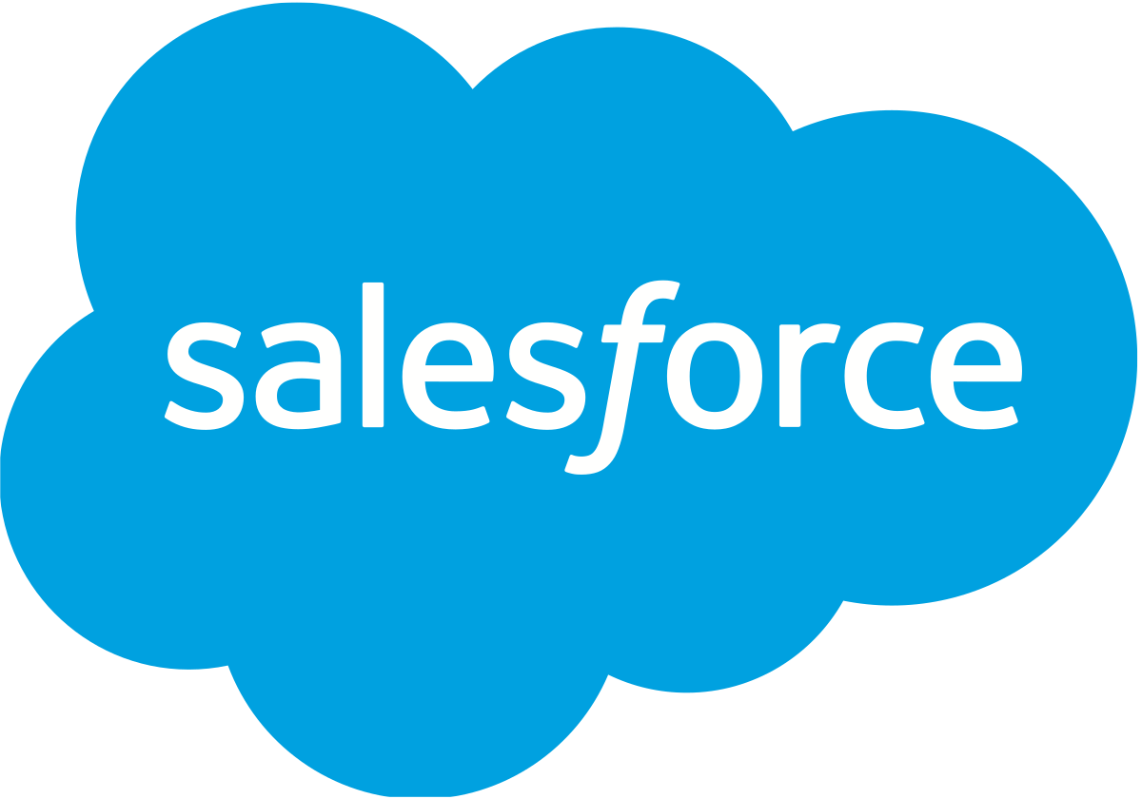
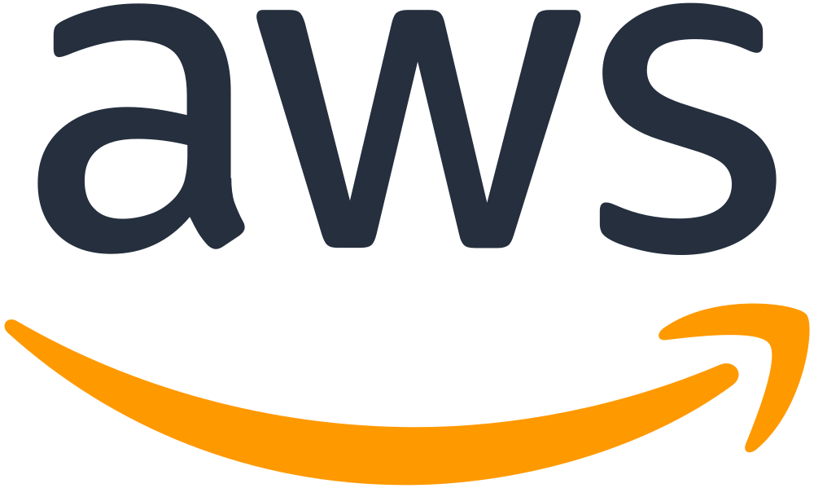
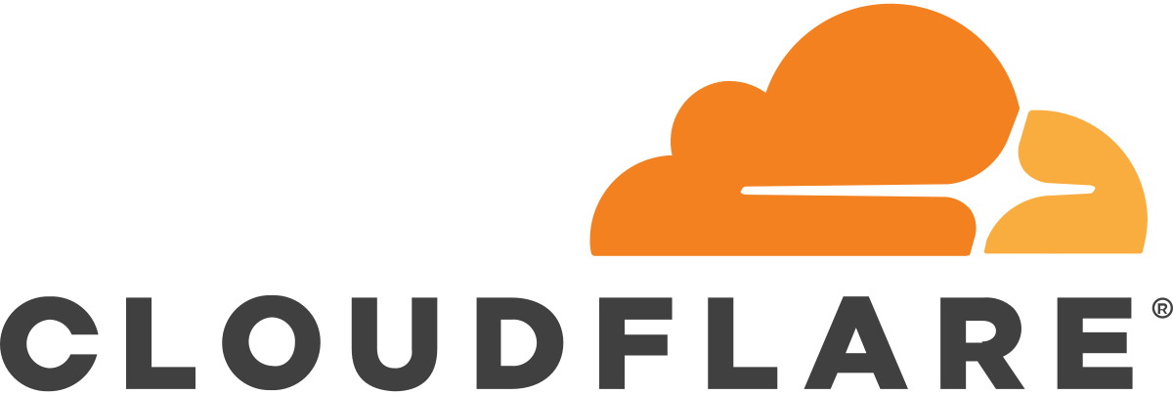
Applications and workloads pillar
Solution
Salesforce as CRM application, integrated Cloudflare for web security and Amazon Web Services (AWS) for hosting.

Slide 13
Applications and workloads pillar
rationale
Salesforce is a leading CRM platform with extensive built-in security features and a strong focus on data protection, making it an ideal choice for modernizing your business application with Zero Trust principles. Cloudflare provides additional layers of security for web applications, protecting against DDoS attacks, data breaches, and other web threats. AWS offers a secure and scalable cloud environment for hosting the CRM, with advanced security features and compliance certifications.

Slide 14
Applications and workloads pillar
implementation
Implement Salesforce CRM, configuring its robust access control and data encryption features to protect sensitive customer data. Use Salesforce Shield for advanced security, compliance, and auditing capabilities.
Integrate Cloudflare for additional security. It provides a web application firewall (WAF) to protect against common web vulnerabilities, DDoS protection to mitigate the risk of service disruption, and secure content delivery.
Host the CRM on AWS, utilizing its security features like Amazon VPC for network isolation, AWS Identity and Access Management (IAM) for granular access control, and AWS Key Management Service (KMS) for managing encryption keys.
Regularly update and patch the CRM and associated applications to protect against vulnerabilities. Implement automated security monitoring and incident response protocols to quickly identify and mitigate any threats.

Slide 15
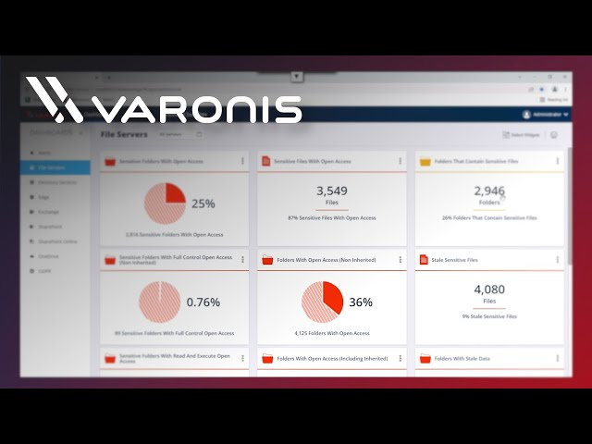
DATA PILLAR
Solution
Varonis Data Security Platform, supplemented with Microsoft Azure Information Protection.

Slide 16
DATA PILLAR
RATIONALE
With a globally distributed workforce and remote access to the CRM, ensuring the security and privacy of data is paramount. Varonis provides advanced data security capabilities, including data classification, access controls, and user behavior analytics. Microsoft Azure Information Protection complements this by offering classification and encryption capabilities for data at rest and in transit.

Slide 17
DATA PILLAR
implementation
Deploy Varonis to monitor and protect data within the CRM. Use its data classification tools to identify and categorize sensitive information, applying appropriate access controls and monitoring policies.
Implement Azure Information Protection to classify, label, and protect documents and emails. This ensures that sensitive information is encrypted and only accessible to authorized users.
Set up automated alerts in Varonis for unusual access patterns or potential data breaches, enabling rapid response to mitigate any data loss or exposure incidents.
Regularly review and update data protection policies to align with evolving data privacy regulations and business needs. Conduct periodic audits and compliance checks to ensure that data handling practices are up to standard.
Implement data loss prevention (DLP) policies to prevent unauthorized sharing or transfer of sensitive information, particularly important for remote employees accessing the CRM from various locations.

Slide 18
references
Microsoft, "What is CRM?," Microsoft Dynamics 365. [Online]. Available: https://dynamics.microsoft.com/en-us/what-is-crm/. [Accessed: Dec. 03, 2023].
Salesforce, "Customer Relationship Management Definition," Salesforce US. [Online]. Available: https://www.salesforce.com/products/what-is-crm/. [Accessed: Dec. 03, 2023].
Oracle, "What is CRM," Oracle. [Online]. Available: https://www.oracle.com/cx/what-is-crm/. [Accessed: Dec. 03, 2023].
Salesforce, "CRM Software from Salesforce.com - Customer Relationship Management," Salesforce.com. [Online]. Available: https://www.salesforce.com/crm/. [Accessed: Dec. 03, 2023].
Microsoft, "What is Azure Information Protection (AIP)?," Microsoft Learn. [Online]. Available: https://learn.microsoft.com/en-us/azure/information-protection/what-is-information-protection. [Accessed: Dec. 03, 2023].
Microsoft, "Azure Information Protection service description," Microsoft Learn. [Online]. Available: https://learn.microsoft.com/en-us/azure/information-protection/overview. [Accessed: Dec. 03, 2023].
Microsoft, "Azure Information Protection documentation," Microsoft Learn. [Online]. Available: https://learn.microsoft.com/en-us/azure/information-protection/. [Accessed: Dec. 03, 2023].
Varonis, "Varonis," Varonis.com. [Online]. Available: https://www.varonis.com/. [Accessed: Dec. 03, 2023].
Varonis, "How Varonis Works," Varonis. [Online]. Available: https://www.varonis.com/how-it-works/. [Accessed: Dec. 03, 2023].
Varonis, "Varonis: We Protect Data," Varonis.com. [Online]. Available: https://www.varonis.com/. [Accessed: Dec. 03, 2023].
Edureka, "AWS," Edureka.co. [Online]. Available: https://www.edureka.co/blog/what-is-aws/. [Accessed: Dec. 03, 2023].
Amazon, "Overview of Amazon Web Services," docs.aws.amazon.com. [Online]. Available: https://docs.aws.amazon.com/aws-technical-content/latest/aws-overview/aws-overview.pdf. [Accessed: Dec. 03, 2023].
Amazon, "What is AWS," aws.amazon.com. [Online]. Available: https://aws.amazon.com/what-is-aws/. [Accessed: Dec. 03, 2023].
Cloudflare, "About us," Cloudflare.com. [Online]. Available: https://www.cloudflare.com/about-overview/. [Accessed: Dec. 03, 2023].
Cloudflare, "What is Cloudflare?," Cloudflare.com. [Online]. Available: https://www.cloudflare.com/learning/what-is-cloudflare/. [Accessed: Dec. 03, 2023].
Cloudflare, "What is Cloudflare? · Cloudflare Fundamentals docs," developers.cloudflare.com. [Online]. Available: https://developers.cloudflare.com/fundamentals/get-started/what-is-cloudflare/. [Accessed: Dec. 03, 2023].
Cloudflare, "Why Cloudflare?," Cloudflare.com. [Online]. Available: https://www.cloudflare.com/why-cloudflare/. [Accessed: Dec. 03, 2023].
Salesforce, "What is Salesforce? - What does Salesforce do?," Salesforce.com. [Online]. Available: https://www.salesforce.com/products/what-is-salesforce/. [Accessed: Dec. 03, 2023].
Salesforce, "Salesforce - Overview," investor.salesforce.com. [Online]. Available: https://investor.salesforce.com/about-us/overview/default.aspx. [Accessed: Dec. 03, 2023].

Slide 19
About us
Group 9

